Slide 2
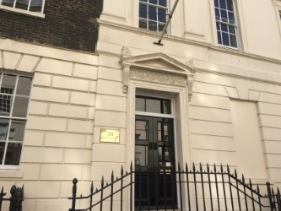
Holmes Investment Properties
Contact:
Holmes Investment Properties
53 Davies Street, Mayfair, London, W1K 5KH
Martin Helme – 07779 601 541
James Holmes – 07717 411 268
David Dean – 07962 802 540

